Slide 1
The Fundamental of Mobile Robot
Machine Perception and Interaction Group (MPIG)
assignments.shmtu@gmail.com

Slide 2
Send an email with specified subject ‘Robot stuff’ to
assignments.shmtu@gmail.com
An automatic reply will come.
All you need would be included!

Slide 3

assignments.shmtu@gmail.com

Slide 4


All the codes accompanying this course are open-sourced at Github.
The project homepage:
https://github.com/sunzuolei/robotcourse
The git repository:
https://github.com/sunzuolei/robotcourse.git
Learn more about git:
http://en.wikipedia.org/wiki/Git_(software)
The best GUI-based git client on Windows:
https://code.google.com/p/tortoisegit/

Slide 5

All From Bayes…
Thomas Bayes
(1701 –1761)
http://en.wikipedia.org/wiki/Thomas_Bayes

Slide 6
The formal definition of probability

Slide 7
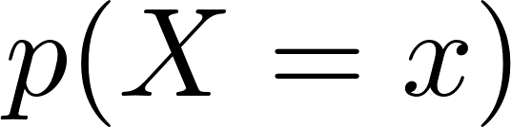

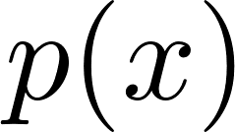
Let X denote a random variable and x denote a specific event that X might take on. The probability that the random variable X has value x can be presented as:
Discrete space
Abbreviation

Slide 8
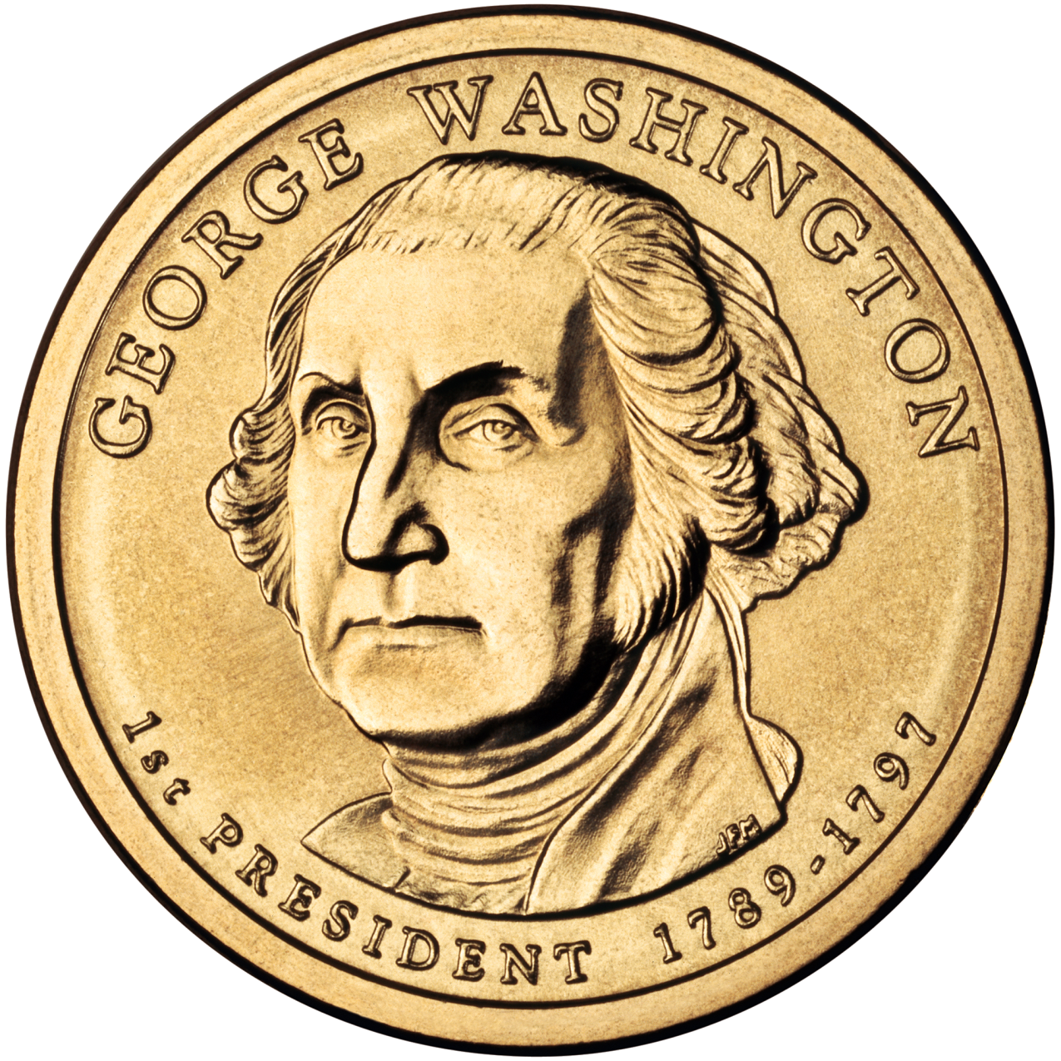
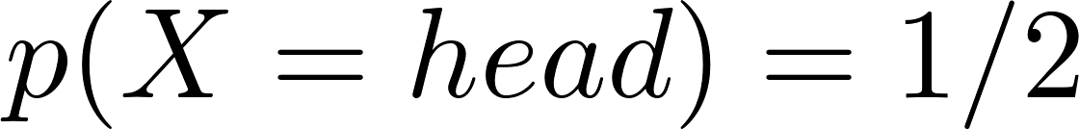
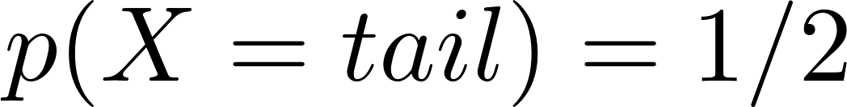
A fair coin is characterized by
Abbreviation

Slide 9
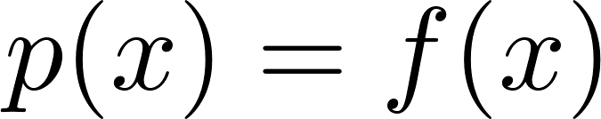
Probability Density Function (PDF)
Continuous space

Slide 10
Non-negative
Sums up/ integrates to one
Discrete probability distribution always sums up to one
A PDF always integrates to one

Slide 11
Joint distribution
It describes the probability of the event that the random variable X takes on the value x and that Y takes on the value y

Slide 12
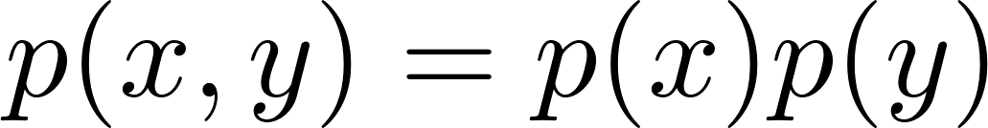
Independence
X and Y are independent

Slide 13
Conditional distribution
Often, random variables carry information about other random variables. Suppose we
already know that Y ’s value is y, and we would like to know the probability that X’s
value is x conditioned on that fact.

Slide 14
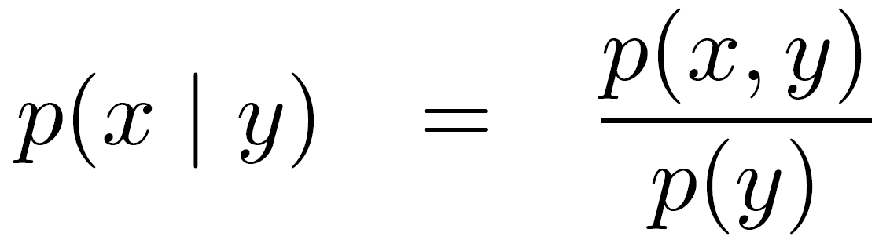
Conditional distribution
p(y) is not 0

Slide 15

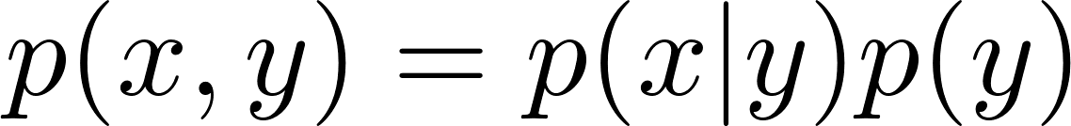

Slide 16
Chain rule

Slide 17

p(y) is not 0
Conditional distribution

Slide 18
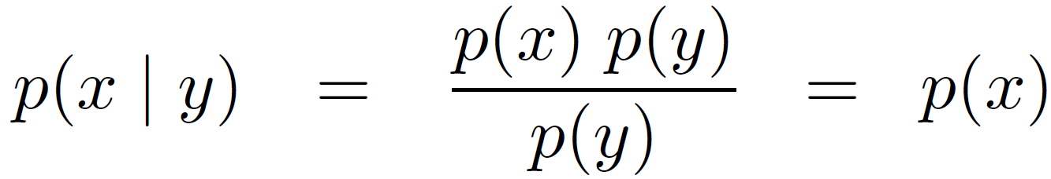
p(y) is not 0
X and Y are independent

Slide 19

What does the expression imply?

Slide 20
if X and Y are independent, Y tells us nothing about the value of X.
There is no advantage of knowing Y if our interest pertains to knowing X

Slide 21
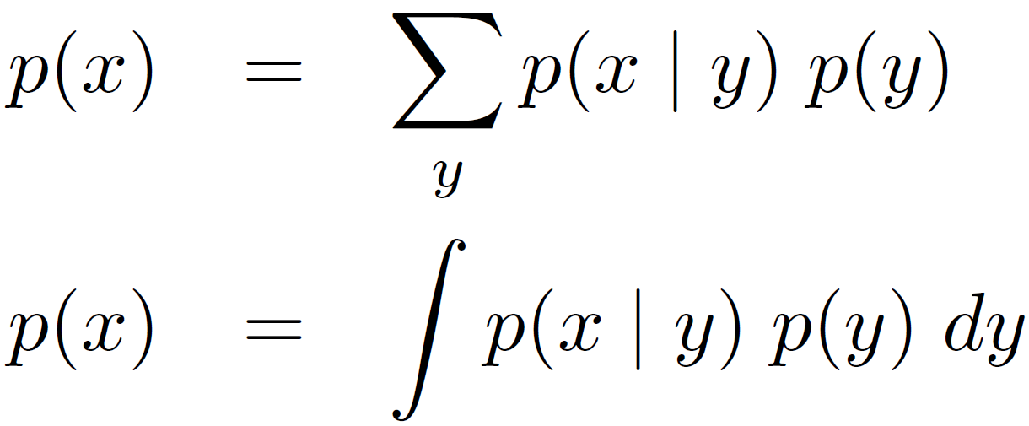
Theorem of total probability
Discrete space
Continuous space

Slide 22
Marginal probability
Discrete space
Continuous space
Marginal probability

Slide 23

Theorem of total probability
Marginalization

Slide 24
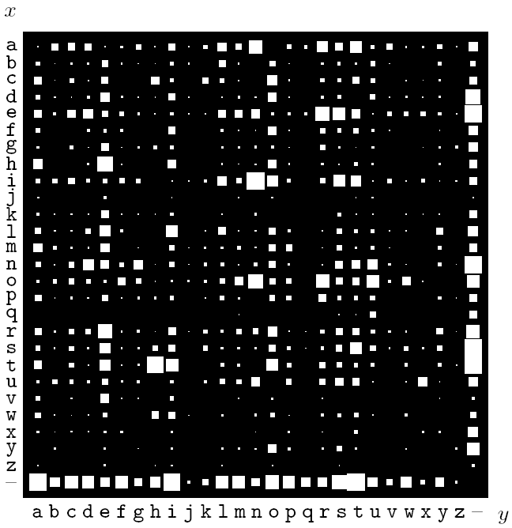
Joint PDF over English digrams xy (Mackay 03)

Slide 25
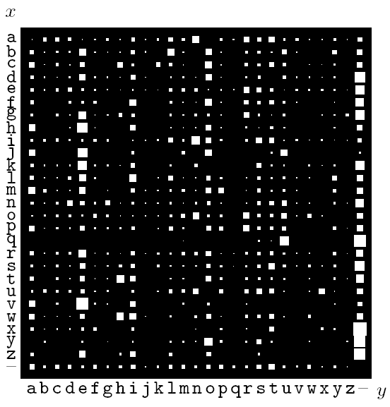
Conditional p(y|x) (Mackay 03)

Slide 26
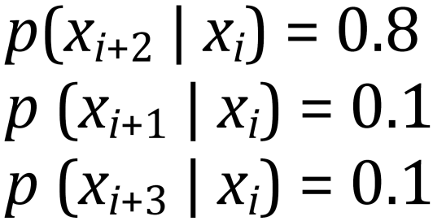

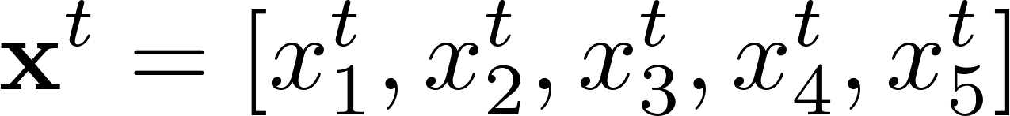
Inaccurate motion model
Motion update
U = 2
0.1
0.8
0.1
0
0.5
0
0.5
0
0.4
0.05
0.05
0.4
0.05
0.05

Slide 27
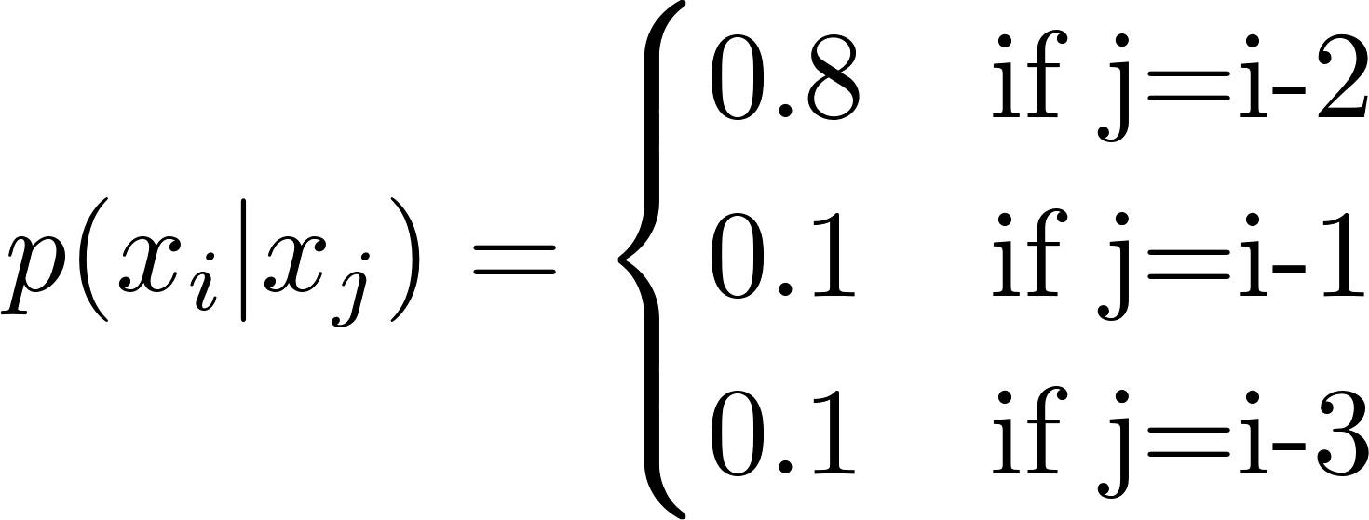
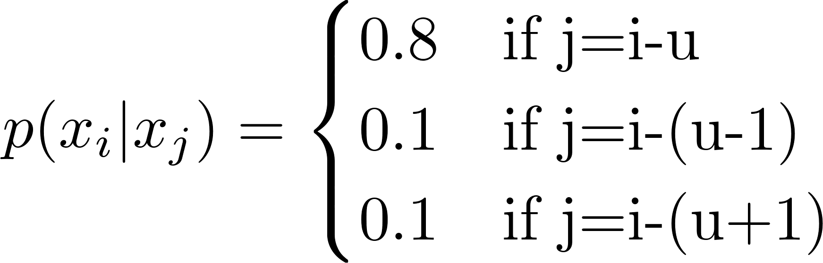
Inaccurate motion model
Motion update

Slide 28
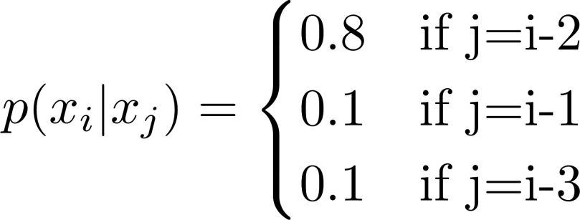
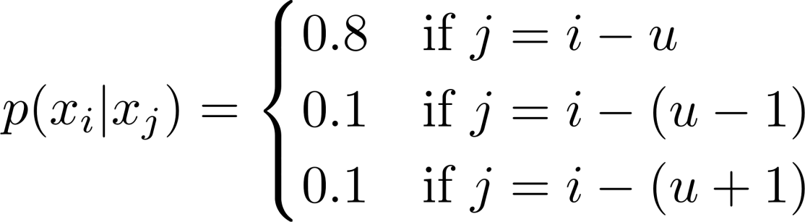
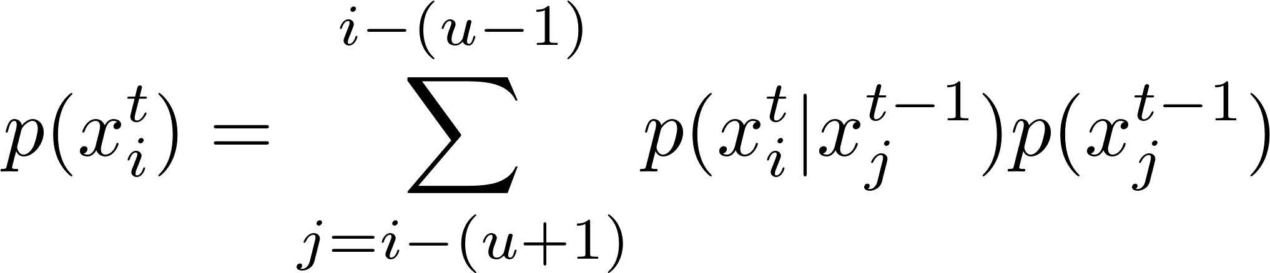
0
0.5
0
0.5
0
0.4
0.05
0.05
0.4
0.05
0.05

Slide 29
Which rule does it represent?

Slide 30
Motion update or process update or prediction or motion propagation or state transition
Theorem of total probability
Marginalization
Convolution

Slide 31
Which rule does it represent?

Slide 32
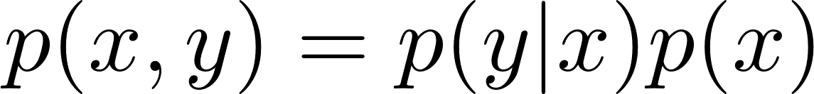
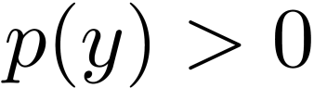
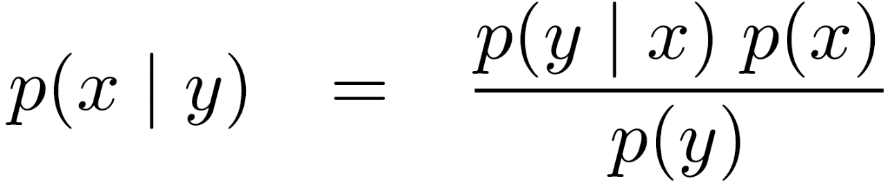
Chain rule

Slide 33
Bayes rule

Slide 34

The inverse of conditional

Slide 35
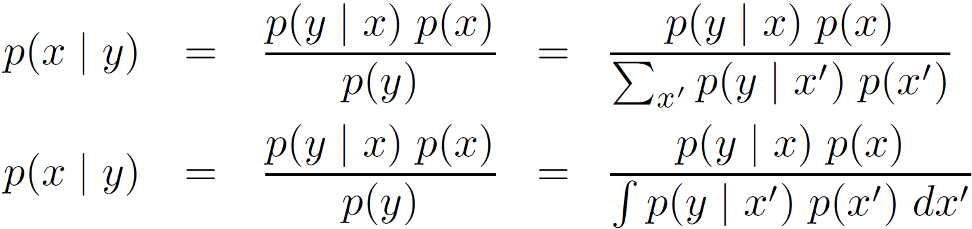
Continuous space
Discrete space
Theorem of total probability
Bayes rule

Slide 36

Observation model
Prior
Posterior
Measurements
Bayes rule

Slide 37
It is often coined “generative model,” since it describes how state variables X cause sensor measurements Y
Prior
Posterior
Measurements
Bayes rule

Slide 38
It is often coined “generative model,” since it describes how state variables X cause sensor measurements Y
Prior
Posterior
Measurements
Bayes rule plays a predominant role in probabilistic robotics.

Slide 39
It is often coined “generative model,” since it describes how state variables X cause sensor measurements Y
Prior
Posterior
Doesn’t depend on x. will be the same for any value x in the posterior
Normalizer

Slide 40
Let’s dive into Bayes rule with some demos…

Slide 41
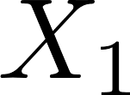
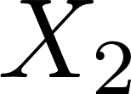
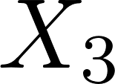
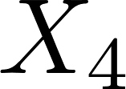
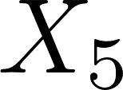
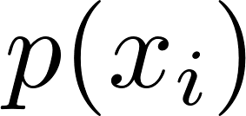
0.2
0.2
0.2
0.2
0.2

Slide 42
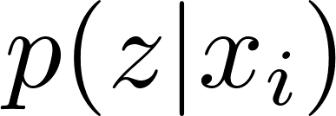
0.2
0.2
0.2
0.2
0.2
Red cell * 0.6
Green cell *0.2
Likelihood

Slide 43
0.2
0.2
0.2
0.2
0.2
Red cell * 0.6
Green cell *0.2
0.2
0.6
0.6
0.2
0.2

Slide 44
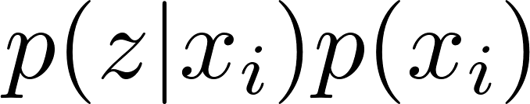
0.2
0.2
0.2
0.2
0.2
0.2
0.6
0.6
0.2
0.2
0.04
0.12
0.12
0.04
0.04

Slide 45
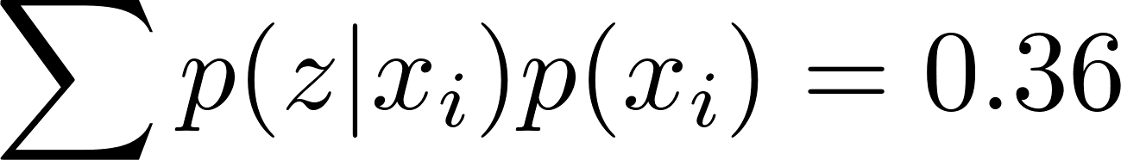
0.2
0.2
0.2
0.2
0.2
0.2
0.6
0.6
0.2
0.2
0.04
0.12
0.12
0.04
0.04
We need normalization!

Slide 46
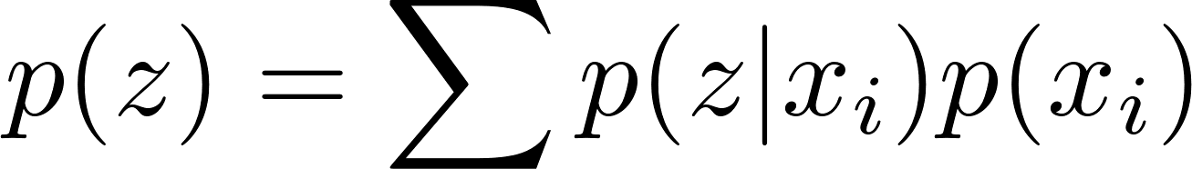
0.2
0.2
0.2
0.2
0.2
0.2
0.6
0.6
0.2
0.2
0.04
0.12
0.12
0.04
0.04
How can it be interpreted?

Slide 47
0.2
0.2
0.2
0.2
0.2
0.2
0.6
0.6
0.2
0.2
0.04
0.12
0.12
0.04
0.04
Marginal probability
Theorem of total probability

Slide 48
0.2
0.2
0.2
0.2
0.2
0.2
0.6
0.6
0.2
0.2
0.04
0.12
0.12
0.04
0.04
Marginal probability
Marginalization

Slide 49
0.2
0.2
0.2
0.2
0.2
0.2
0.6
0.6
0.2
0.2
0.04
0.12
0.12
0.04
0.04
Marginal probability
Does p(z) depend on p(x_{i})?

Slide 50
0.2
0.2
0.2
0.2
0.2
0.2
0.6
0.6
0.2
0.2
0.04
0.12
0.12
0.04
0.04
0.04+0.12+0.12+0.04+0.04 = 0.36

Slide 51
0.2
0.2
0.2
0.2
0.2
0.6
0.2
0.2
0.6
0.6
0.12
0.04
0.04
0.12
0.12
0.04+0.12+0.12+0.04+0.04 = 0.36
0.12+0.04+0.04+0.12+0.12 = 0.44

Slide 52
0.2
0.2
0.2
0.2
0.2
0.6
0.2
0.2
0.6
0.6
0.12
0.04
0.04
0.12
0.12
0.36
p(z) doesn’t depend on
where the robot is, only depends on the measurements.
0.44

Slide 53
0.2
0.2
0.2
0.2
0.2
0.6
0.2
0.2
0.6
0.6
0.12
0.04
0.04
0.12
0.12
No matter which grid cell we consider, the p(z) is the same
0.36
0.44

Slide 54
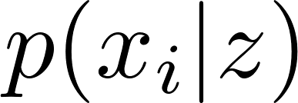
0.2
0.2
0.2
0.2
0.2
0.2
0.6
0.6
0.2
0.2
0.04
0.12
0.12
0.04
0.04
0.36
Posterior

Slide 55
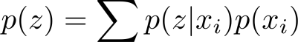
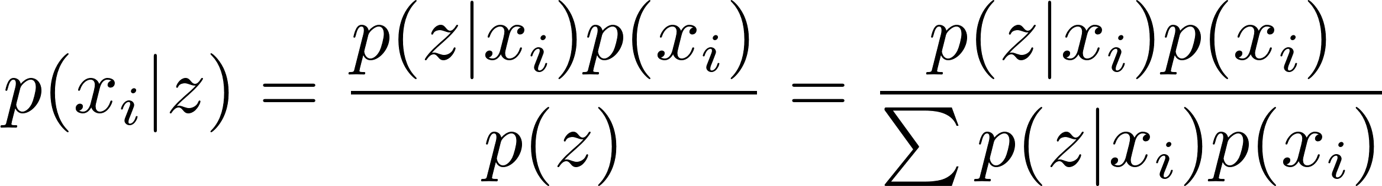
0.2
0.2
0.2
0.2
0.2
0.2
0.6
0.6
0.2
0.2
0.04
0.12
0.12
0.04
0.04
1/9
1/3
1/3
1/9
1/9
0.36

Slide 56
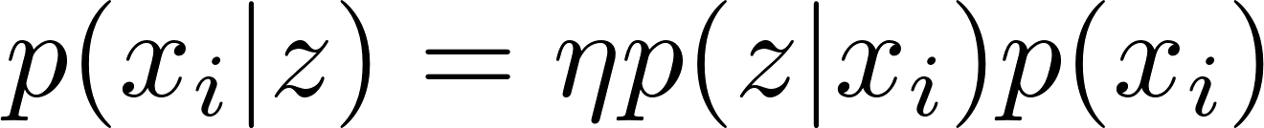
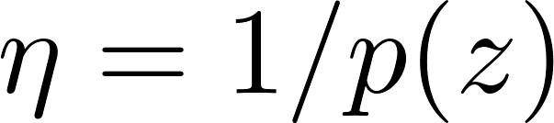
Observation update or update
Bayes rule
Normalized posterior
Non-normalized posterior

Slide 57
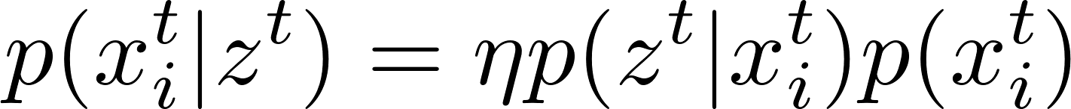
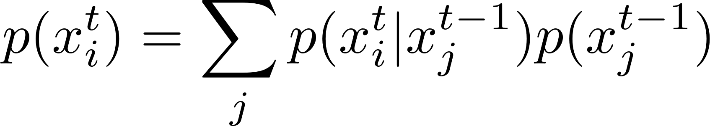
Bayes rule
Gain information
Observation update or update
Sense
Move
Motion update or prediction
Lose information
Initial belief
Theorem of total probability

Slide 58
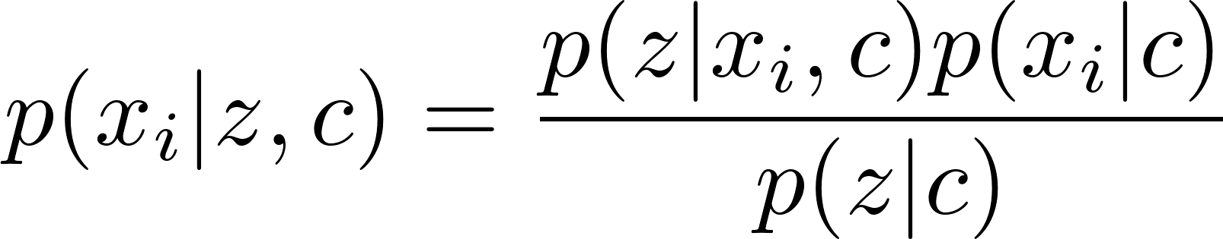
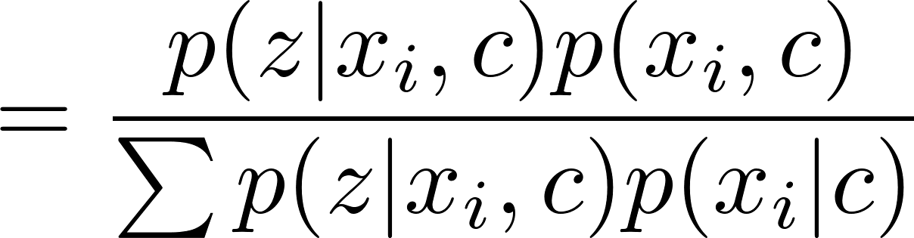
The conditional form of Bayes rule

Slide 59
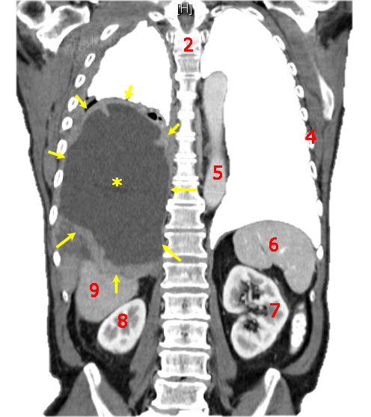
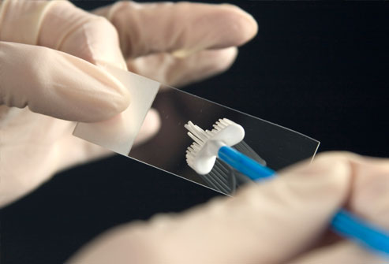
Apply Bayes rule to cancer test

Slide 60
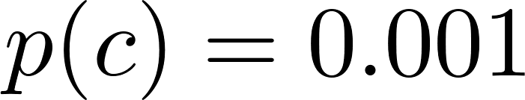
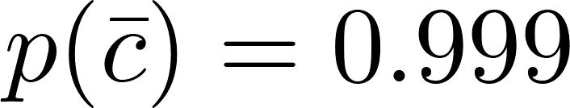
The probability of having cancer
The probability of not having cancer
Suppose the lung cancer is very rare

Slide 61
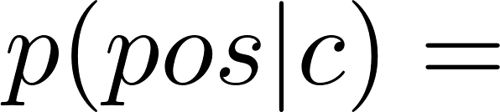
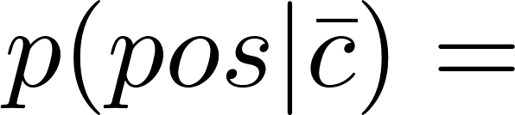
The probability of having cancer
The probability of not having cancer
Suppose we have a test that is pretty good at identifying cancer in patients (it does so with 0.8 probability), but occasionally (with probability 0.1) misdiagnoses cancer in a healthy patient

Slide 62
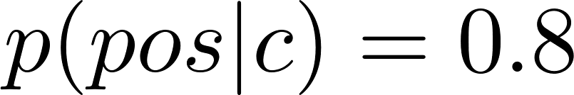


The probability of having cancer
The probability of not having cancer
Probability of a positive test if patient has cancer
Probability of a positive test in a cancer free patient
Unfortunately, one day you received a positive test report!!

Slide 63

The probability of having cancer
The probability of not having cancer
Probability of a positive test if patient has cancer
Probability of a positive test in a cancer free patient
DO I DEFINITELY HAVE CANCER?
You ask yourself all days…

Slide 64


The probability of having cancer
The probability of not having cancer
Probability of a positive test if patient has cancer
Probability of a positive test in a cancer free patient
Let’s compute with Bayes rule…

Slide 65

Bayes rule
How can p(y) be calculated?

Slide 66
Bayes rule
Theorem of total probability

Slide 67

Bayes rule
Normalized posterior
Non-normalized posterior

Slide 68

Bayes rule
Normalized posterior
Non-normalized posterior

Slide 69

Bayes rule

Slide 70


You are most probably cancer-free …
0.0079

Slide 71

Red * 0.6
Green *0.2
Connect cancer test to grid-based localization

Slide 72



Red * 0.6
Green *0.2
Cancer * 0.8
None *0.1
Positive
0.001
0.999

Slide 73
What’s the likelihood of each cell?
Cancer * 0.8
None *0.1
Positive
0.001
0.999

Slide 74


Normalization
0.0008 + 0..0999 = 0.1007
0.0008
0.0999
Cancer * 0.8
None *0.1
Positive
0.001
0.999

Slide 75
Normalization
0.0079
0.9921
0.0008 + 0..0999 = 0.1007
0.0008
0.0999
Cancer * 0.8
None *0.1
Positive
0.001
0.999

Slide 76

Cancer * 0.8
None *0.1
Positive
0.001
0.999

Slide 77


Cancer * 0.8
None *0.1
Positive
0.001
0.999

Slide 78
Bayes rule

Slide 79
Let’s implement this！

Slide 80
P12
pCan = 0.001;
pNon = 0.999;
z = 'positive';
% z = 'negative';
pPosCan = 0.8;
pPosNon = 0.1;
if strcmp('positive', z)
p = [pPosCan * pCan, pPosNon * pNon];
else
p = [(1 - pPosCan) * pCan, (1 - pPosNon) * pNon];
end
p = p / sum(p);
fprintf('The probability of having cancer given the %s test:\n', z);
disp(p(1));
fprintf('The probability of cancer free given the %s test:\n', z);
disp(p(2));

Slide 81
The probability of having cancer
The probability of not having cancer
Probability of a positive test if patient has cancer
Probability of a positive test in a cancer free patient
If you get a NEGTIVE test report, what’s the probability that you have cancer?

Slide 82

The probability of having cancer
The probability of not having cancer
Probability of a positive test if patient has cancer
Probability of a positive test in a cancer free patient

Slide 83


The probability of having cancer
The probability of not having cancer
Probability of a positive test if patient has cancer
Probability of a positive test in a cancer free patient
What are the following stuff:

Slide 84
The probability of having cancer
The probability of not having cancer
Probability of a positive test if patient has cancer
Probability of a positive test in a cancer free patient
Probability of a negative test if patient has cancer
Probability of a negative test in a cancer free patient

Slide 85


How to compute it with Bayes rule?

Slide 86



Slide 87


Slide 88



Your goldfish and a dishonest roommate

Slide 89
You are keeping a goldfish, you cherish it so much. Unfortunately, you must be absent for a couple of days. You know it might die in your absence, and the chance is 2%.

Slide 90
You phone your roommate every morning, say “Does my fish die?”. The guy is not very truthful, every time you ask her a question, there is a 10% chance that she just lies.

Slide 91

Bayes rule
One morning, you phone her, ask the same question again, she says, “Yes, it dies”
What’s the true probability of the fish’s death?

Slide 92


You are keeping a goldfish, you cherish it so much. Unfortunately, you must be absent for a couple of days. You know it might die in your absence, and the chance is 2%.

Slide 93
You phone your roommate every morning, say “Does my fish die?”. The guy is not very truthful, every time you ask her a question, there is a 10% chance that she just lies.

Slide 94
You phone your roommate every morning, say “Does my fish die?”. The guy is not very truthful, every time you ask her a question, there is a 10% chance that she just lies.

Slide 95

One morning, you phone her, ask the same question again, she says, “Yes, it dies”

Slide 96
The posterior can be computed in two ways. They are essentially the same!

Slide 97

0.02*0.9=0.018
0.98*0.1=0.098
0.018+0.098=0.116
0.018/0.116=0.1552
0.098/0.116=0.8448
Die * 0.9
Alive *0.1
Bayes rule

Slide 98
0.018+0.098=0.116
0.018/0.116=0.1552
0.098/0.116=0.8448
Die * 0.9
Alive *0.1
Bayes rule

Slide 99

=
0.018/0.116=0.1552
0.098/0.116=0.8448
Die * 0.9
Alive *0.1
Bayes rule

Slide 100
=

Slide 102
Suppose a robot obtains measurement z. What is P(open|z) given P(z|open) ?

Slide 103
P(z|open) = 0.6 P(z|¬open) = 0.3
P(open) = P(¬open) = 0.5
Why do P(z|open) and P(z|¬open) not sum up to ONE?

Slide 104
P(z|open) = 0.6 P(z|¬open) = 0.3
P(open) = P(¬open) = 0.5
Bayes rule
P(open|z)
How is posterior computed?

Slide 105
P(z|open) = 0.6 P(z|¬open) = 0.3
P(open) = P(¬open) = 0.5
Bayes rule
P(open|z)

Slide 106
Independence
X and Y are independent

Slide 107


Conditional independence
Conditional independence plays an important role in probabilistic robotics. It applies whenever a variable y carries no information about a variable x if another variable’s value z is known.

Slide 108

Conditional independence
(Absolute) Independence
Conditional independence does not imply (absolute) independence

Slide 109
Conditional independence
(Absolute) Independence

Slide 110
Dynamic Bayes network (DBN)

Slide 111
Move
Sense
motions = {stop, right, down, down, right};
measurements = {'green', 'green', 'green' ,'green', 'green'};

Slide 112





Slide 113














Conditional independence

Slide 114
A state xt will be called complete if it is the best predictor of the future. Put differently, completeness entails that knowledge of past states, measurements, or controls carry no additional information that would help us to predict the future more accurately.
Complete state
Markov chains
No variables prior to xt may influence the stochastic evolution of future states, unless this dependence is mediated through the state xt. Temporal processes that meet these conditions are commonly known as Markov chains

Slide 115
Motion model / process model

Slide 116
Graphical model
x₁
x₂
x₃
x₄
x₅
x₆
x₇

Slide 117



Conditional independence

Slide 118
Measurement model / sensor model

Slide 119
Static world
Independent noise
Perfect model, no approximation errors
Markov
Assumptions

Slide 120

Andrey (Andrei) Andreyevich Markov (Russian: Андре́й Андре́евич Ма́рков, in older works also spelled Markoff^{[1]}) (14 June 1856 N.S. – 20 July 1922) was a Russian mathematician. He is best known for his work on stochastic processes. A primary subject of his research later became known as Markov chains and Markov processes.
http://en.wikipedia.org/wiki/Andrey_Markov

Slide 121

Dynamic Bayes network

Slide 122
Recursive Bayes filtering

Slide 123


Slide 124
Bayes

Slide 125

Bayes rule
Gain information
Observation update or update
Sense
Move
Motion update or prediction
Lose information
Initial belief
Theorem of total probability

Slide 126
Bayes
Markov
Total prob.
Markov
Markov

Slide 127
Bayes rule
Gain information
Observation update or update
Sense
Move
Motion update or prediction
Lose information
Initial belief
Theorem of total probability

Slide 128
Derivation of Bayes filter

Slide 129
张文

Slide 130





Slide 131

$$p\left(x_{t} | z_{1:t},u_{1:t}\right)=\frac{p(x_{t},z_{1:t},u_{1:t})}{p(z_{1:t},u_{1:t})} =\frac{p\left(z_{t} | x_{t},z_{1:t−1},u_{1:t}\right)p(x_{t},z_{1:t−1},u_{1:t})}{p\left(z_{t} | z_{1:t−1},u_{1:t}\right)p(z_{1:t−1},u_{1:t})}$$
$$=\frac{p\left(z_{t} | x_{t},z_{1:t−1},u_{1:t}\right)p\left(x_{t} | z_{1:t−1},u_{1:t}\right)p(z_{1:t−1},u_{1:t})}{p\left(z_{t} | z_{1:t−1},u_{1:t}\right)p(z_{1:t−1},u_{1:t})}$$
$$=\frac{p\left(z_{t} | x_{t},z_{1:t−1},u_{1:t}\right)p\left(x_{t} | z_{1:t−1},u_{1:t}\right)}{p\left(z_{t} | z_{1:t−1},u_{1:t}\right)}$$
$$=ηp\left(z_{t} | x_{t},z_{1:t−1},u_{1:t}\right)p\left(x_{t} | z_{1:t−1},u_{1:t}\right)$$
Bayes rule

Slide 132







Slide 134








Slide 135



The door can be in one of two possible states, open or closed, and only the robot can change the state of the door.
We assume that the robot does not know the state of the door initially.
Uniform distribution

Slide 136

We assume the robot’s sensors are noisy. It has a 0.6 probability of a correct measurement when the door is open, and when the door is closed, the probability of a correct measurement is 0.8.

Slide 137



Slide 138


Slide 139



Prediction
Theorem of total probability

Slide 140



=1*0.5+0*0.5=0.5

Slide 141

=0*0.5+1*0.5=0.5

Slide 142






Slide 143

Now, incorporating the measurement, the belief of X1 will change. We assume that the robot senses the door is open, that mean Z1= sense_poen.

Slide 144





Slide 145



normalization

Slide 146
iteration
This calculation is now iterated for the next time step.For u2 = push and z2 = sense_open, we get

Slide 147
At this point, the robot believes that the door is open with 0.983 probability, hence both its measurements were correct.

Slide 148
Summary
The definition of probability
Joint distribution
Independence
Conditional distribution
Chain rule
Theorem of total probability
Marginal distribution
Conditional Independence
Bayes rule
Demos of Bayes rule
Bayes filter

